Slide 1

BREAST CANCER COIMBRA (BY USING RANDOM FOREST AND DECISION TREE)
Project Supervisor: Dr.Rajashree
Name of the Student: Jami Sahithi Prathyusha
Register Number: 40110476

Slide 2
PRESENTATION OUTLINE
Course Certificate
Introduction
Objectives
System Architecture/ Ideation Map
Module Implementation
Advantages of Machine Learning in Breast Cancer Diagnosis
Application Snapshots
Results and Discussions
Conclusion and Future Work
References

Slide 3
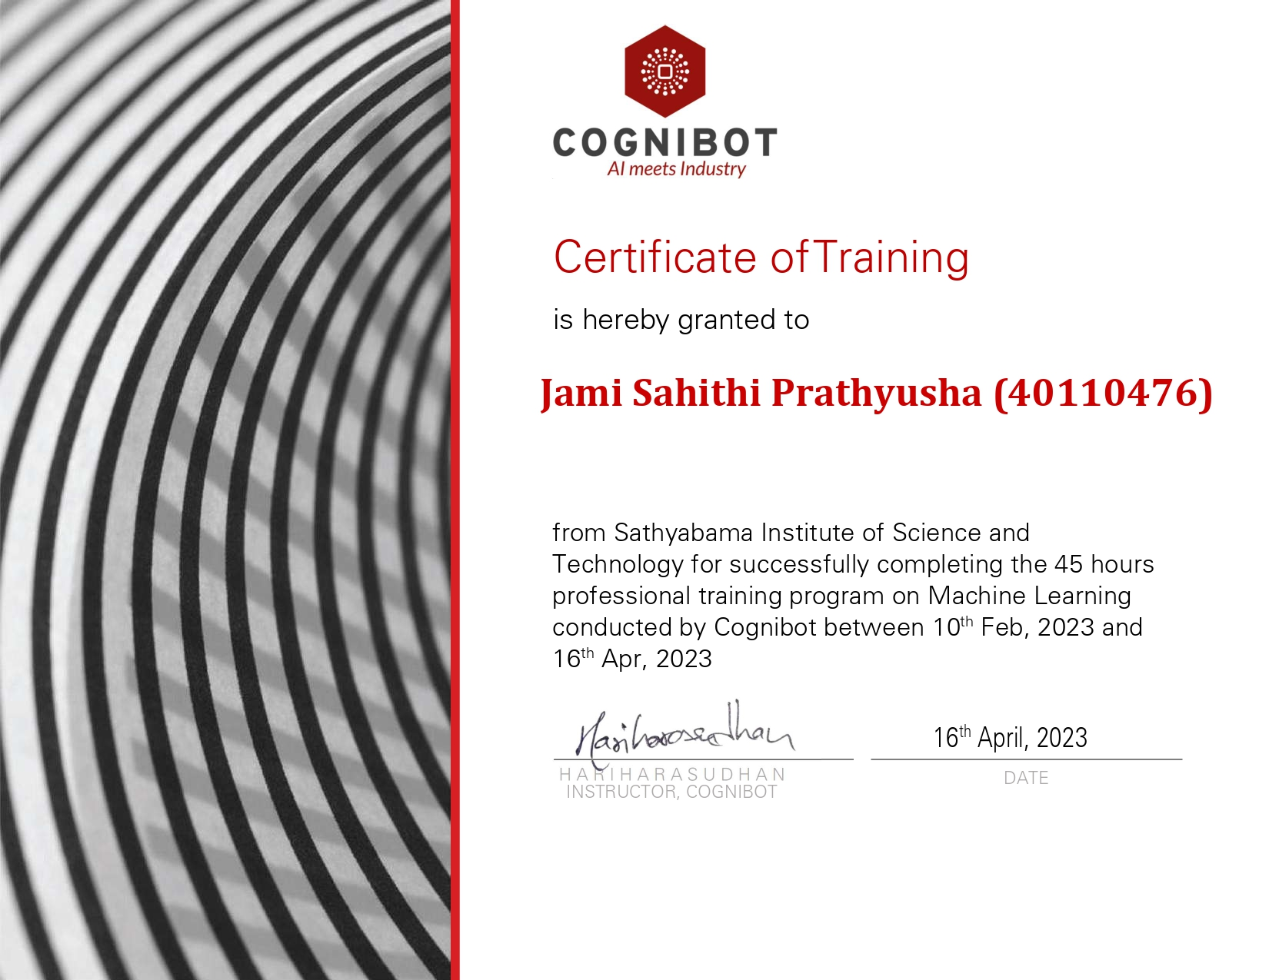
COURSE CERITIFICATE

Slide 4
INTRODUCTION
Breast cancer is a major health concern worldwide, affecting millions of women every year. Early detection and treatment are crucial for the successful management of this disease. In recent years, machine learning algorithms have been increasingly used to aid in the diagnosis and treatment of breast cancer.
This presentation focuses on the use of Random Forest and Decision Tree algorithms in Python for the analysis of Breast Cancer Coimbra dataset.
Breast cancer, the second-leading cause of cancer deaths in women, is the disease women fear most.
Breast cancer can also occur in men, but it’s far less common.
Yet there’s more reason for optimism than ever before.
In the last 30 years, doctors have made great strides in early diagnosis and treatment of the disease and in reducing breast cancer deaths.
80% of breast cancers occur in women older than age 50. In 30s, have a one in 233 chance of developing breast cancer. By age 85, chance is one in eight.

Slide 5
INTRODUCTION
In 1975, a diagnosis of breast cancer usually meant radical mastectomy – removal of the entire breast along with underarm lymph nodes and muscles underneath the breast.
Many techniques are available for the detection of breast cancers among which digital mammography is the familiar and successful technique currently used by the radiologists
The classification goal is to predict the missing attribute values of the data set by using machine learning.
Machine Learning(ML) is a branch of Artificial Intelligence(AI) & Computer Science which focuses on the use of data and algorithms to imitate the way that humans learn and gradually improving accuracy
Improvement in classification accuracy have resulted from growing an ensemble of trees and letting them vote for the most popular class.
Using random forest and decision algorithm we can get the accuracy of breast cancer.
By using Machine Learning it provides mathematical tool to AI.
Decision Trees (DTs) are a non-parametric supervised learning method used for classification and regression

Slide 6
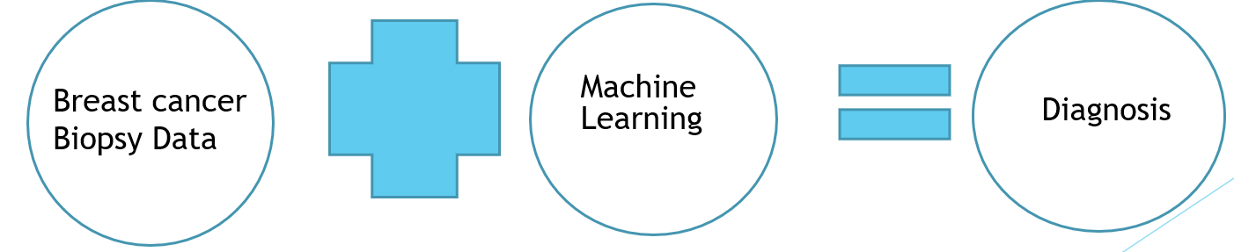
Objectives
This analysis aims to observe which features are most helpful in predicting malignant or benign cancer and to see general trends that may aid us in model selection and hyper parameter selection. The goal is to classify whether the breast cancer is benign or malignant. To achieve this I have used machine learning classification methods to fit a function that can predict the discrete class of new input.

Slide 7
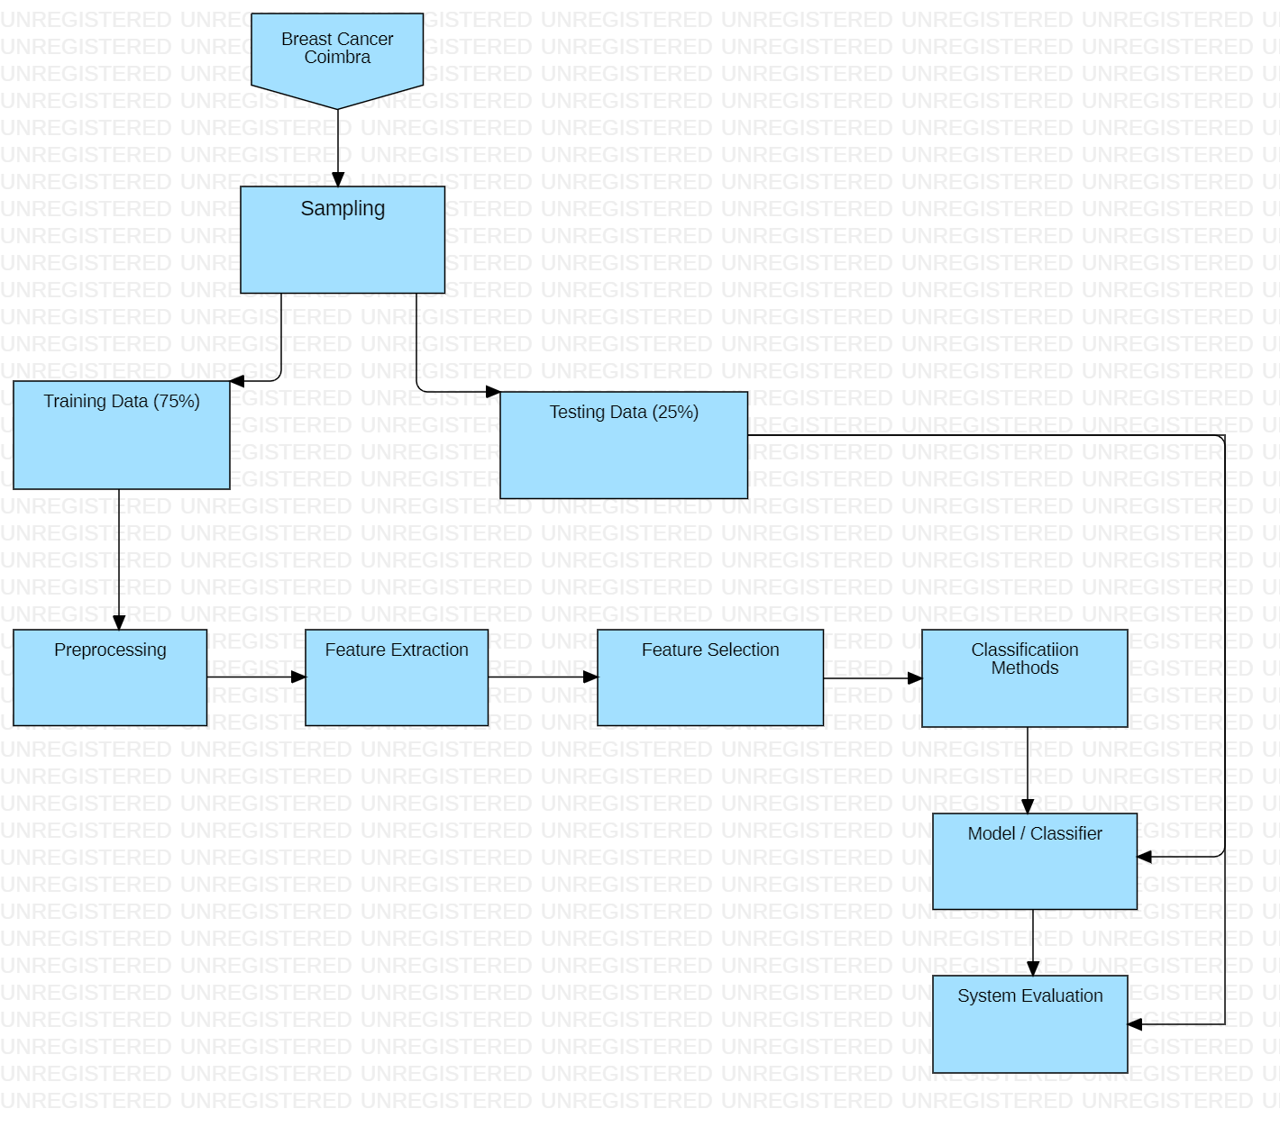
System Architecture/ Ideation Map

Slide 8
PROJECT IMPLEMENTATION
In this project I will demonstrate how to predict the breast cancer using machine learning dataset by using python in the following steps:
Data preparation
Exploratory Data Analysis
Analyzing the correlation to numerical features
Encode categorical features
Using Machine Learning Decision Tree’s classification Algorithm for getting output
Libraries.
Hardware & Software Requirements.
Construction or Fabrication

Slide 9
MODULES USED
LIBRARIES
Numpy
Pandas
Sklearn
DecisionTree Classifier
Random Forest Classifier
Matplotlib
Seaborn

Slide 10
HARDWARE AND SOFTWARE REQUIREMENTS
Software Requirements
Jupyter Notebbok – Project Environment
Numpy – Used to convert 1D array to 2Darray
Pandas – Convert dataset into data-frame
Matplot - Used to visualize the dataset
SkLearn module – To import all types ML algorithm
Hardware Requirements
Any working Laptop
Graphic processing unit
Any Operating systems

Slide 11
METHODOLOGY
There are many classifications algorithms in machine learning, for this project we selected random forest and decision to predict the result.
Step 1: Import the needed modules.
Step 2: Get your dataset and read it.
Step 3: Check your data, if there are any null or NaN values.
Step 4: Fill the null values in each column by calculating the mean each column.
Step 5: After filling the null values check your data if any columns are not needed and drop them.
Step 6: Once the data is clean now we are good to go with the prediction part.
Step7: Start prediction the data by considering Severity.
Step 8: Once predicting the data is completed start visualizing the data.
Step 9: Plot the graphs with the help of data and modules imported.
Step 10: Once visualizing the data is completed start analyzing the data.
Step 11: Generate the results.

Slide 12
Module Implementation
TYPES OF ALGORITMS USED:
Random Forest
Decision Tree
1. Random Forest
The Random Forest algorithm is a popular machine learning algorithm that is widely used for classification and regression tasks. It works by creating multiple decision trees and combining their results to make a final prediction.
In the case of breast cancer diagnosis, the Random Forest algorithm can be trained on the Breast Cancer Coimbra dataset to predict whether a patient has breast cancer or not based on their age, BMI, glucose levels, blood pressure, and other relevant factors.

Slide 13
Module Implementation
2. Decision Tree
The Decision Tree algorithm is another popular machine learning algorithm that is used for classification and regression tasks. It works by creating a tree-like model of decisions and their possible consequences.
In the case of breast cancer diagnosis, the Decision Tree algorithm can be trained on the Breast Cancer Coimbra dataset to predict whether a patient has breast cancer or not based on their age, BMI, glucose levels, blood pressure, and other relevant factors. The algorithm creates a tree-like model of decisions and their possible outcomes, allowing doctors to make more informed decisions about patient care.

Slide 14
Advantages of Machine Learning in Breast Cancer Diagnosis
The use of machine learning algorithms like Random Forest and Decision Tree in breast cancer diagnosis has several advantages. These algorithms are able to analyze large amounts of data quickly and accurately, which can help doctors make more informed decisions about patient care.
Machine learning algorithms can also identify patterns and trends in the data that may not be immediately apparent to human analysts, allowing for more accurate and efficient diagnosis and treatment of breast cancer.

Slide 15
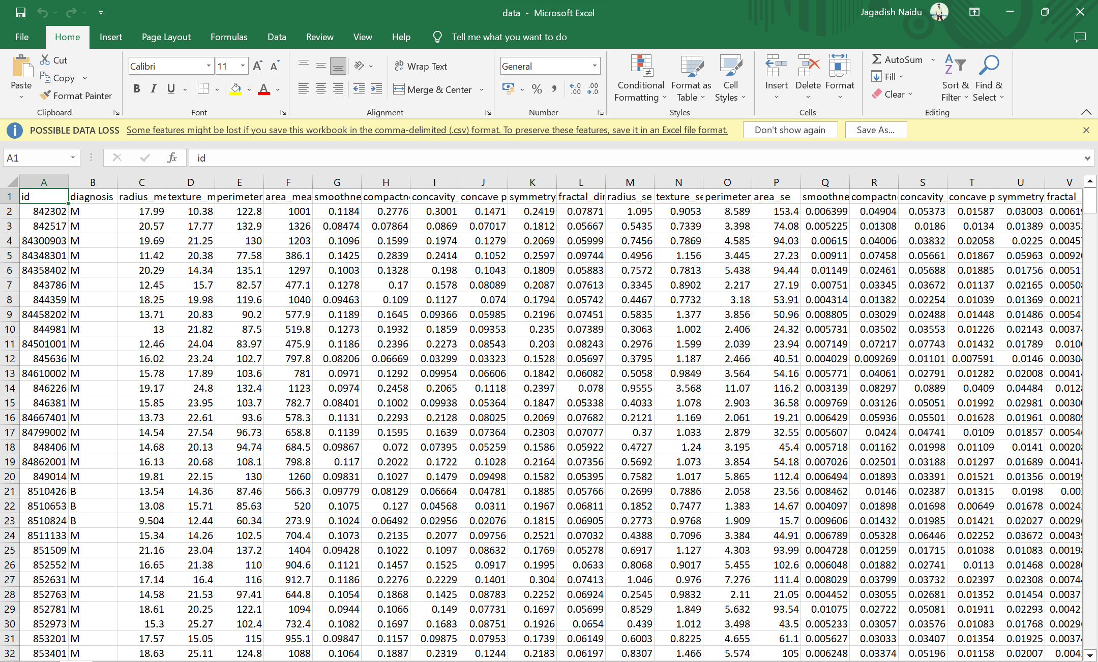
Sample Snapshot

Slide 16
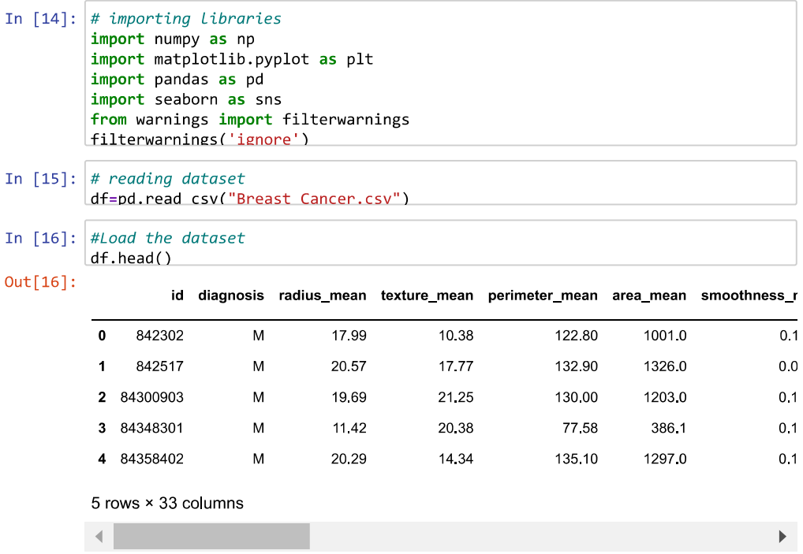
RESULTS AND DISCUSSION

Slide 17
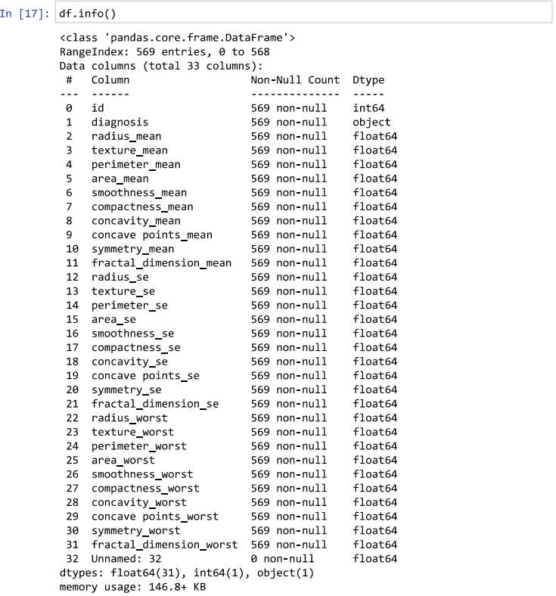
RESULTS AND DISCUSSION

Slide 18
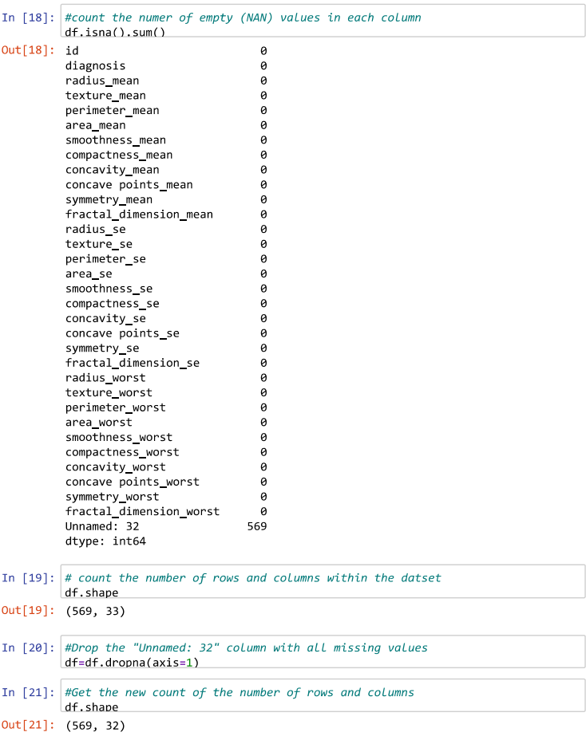
RESULTS AND DISCUSSION

Slide 19
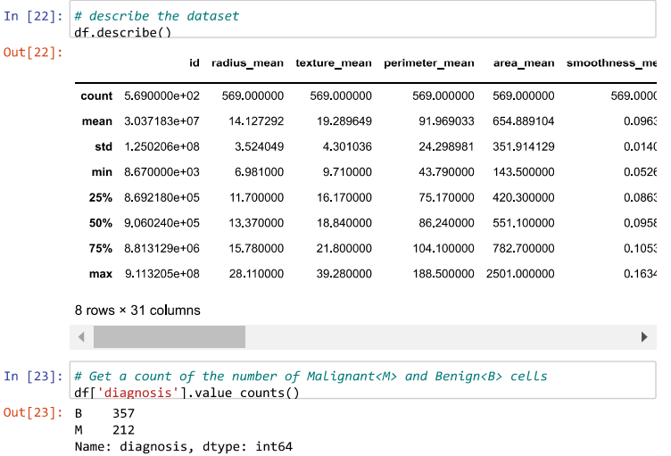
RESULTS AND DISCUSSION

Slide 20
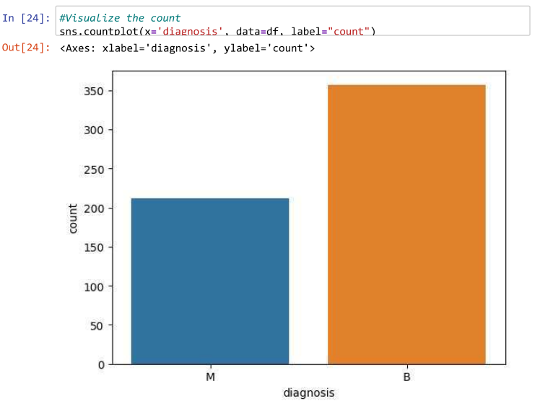
RESULTS AND DISCUSSION

Slide 21
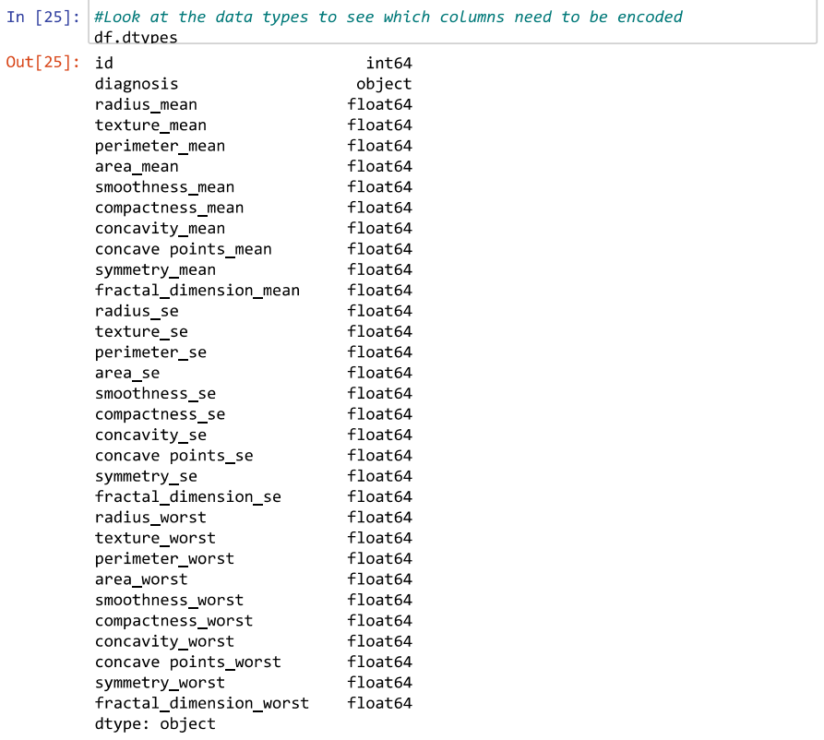
RESULTS AND DISCUSSION

Slide 22
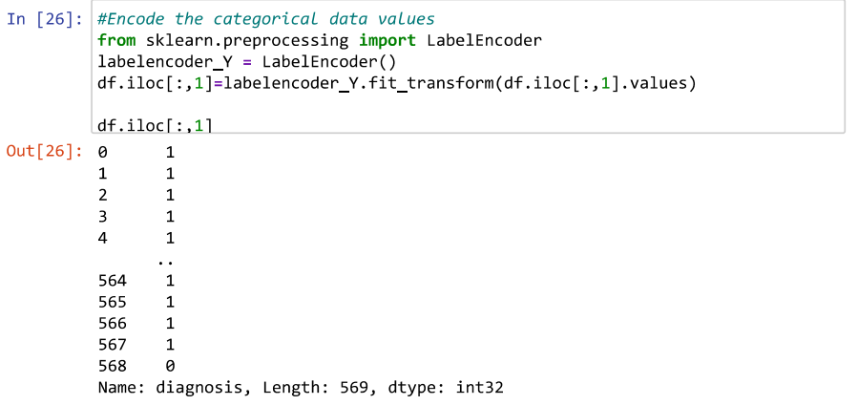
RESULTS AND DISCUSSION

Slide 23
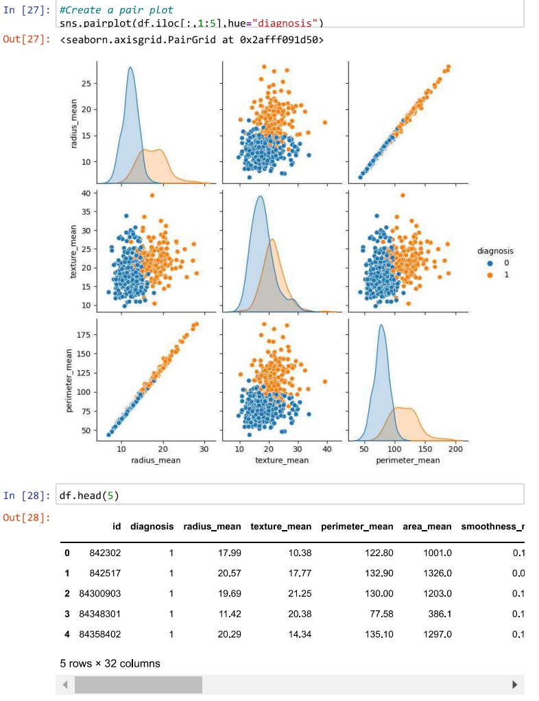
RESULTS AND DISCUSSION

Slide 24
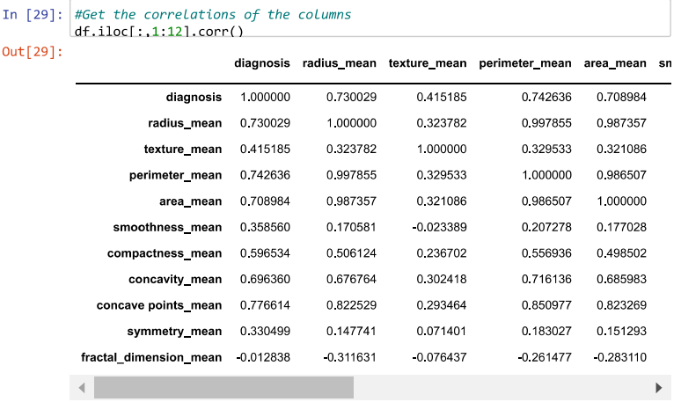
RESULTS AND DISCUSSION

Slide 25
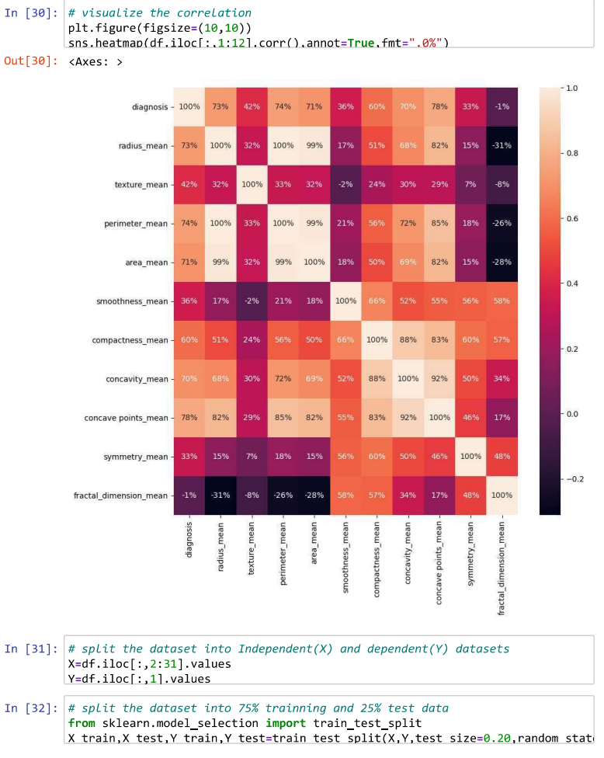
RESULTS AND DISCUSSION

Slide 26
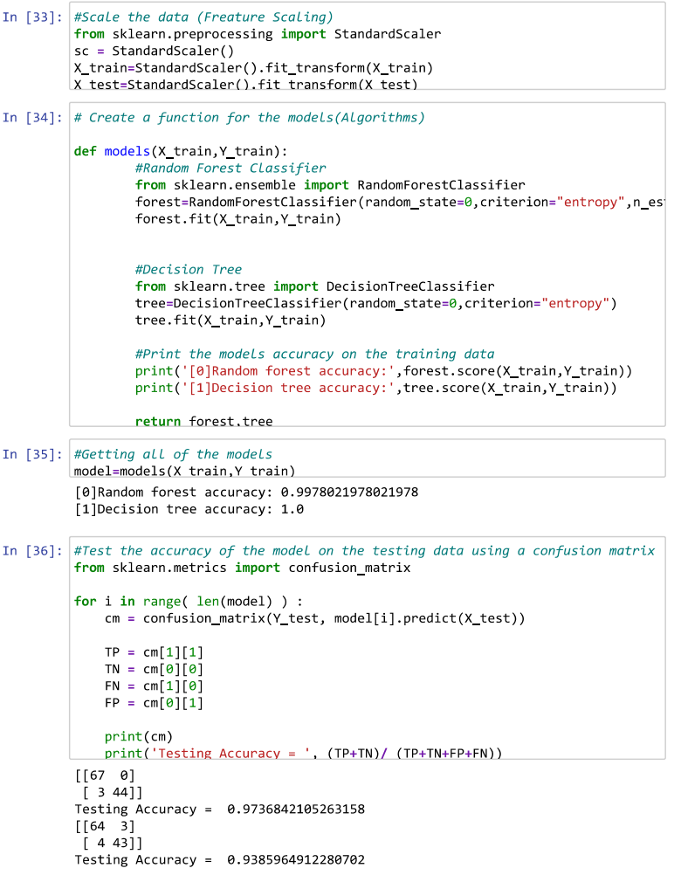
RESULTS AND DISCUSSION

Slide 27
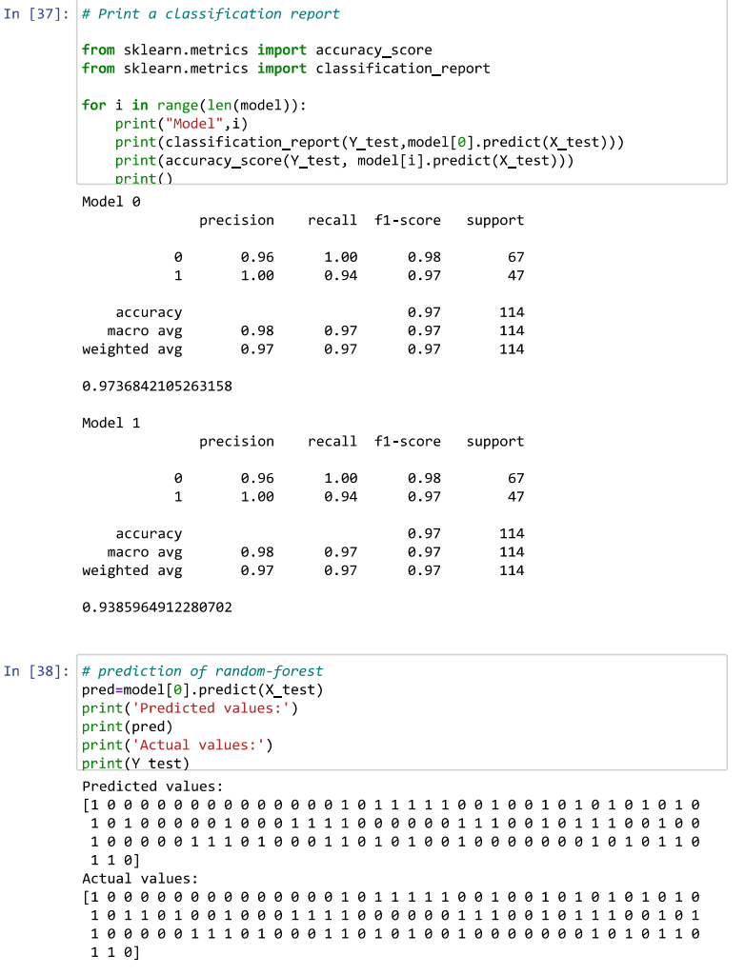
RESULTS AND DISCUSSION

Slide 28
Conclusion
Scope: This prediction can help the doctor to find the last variable so he can suggest the necessary steps to overcome breast cancer.
The use of machine learning algorithms like Random Forest and Decision Tree in breast cancer diagnosis is a promising area of research that has the potential to revolutionize the way we diagnose and treat this disease. By analyzing large amounts of data quickly and accurately, these algorithms can help doctors make more informed decisions about patient care and ultimately improve patient outcomes.
Further research is needed to fully understand the potential of machine learning in breast cancer diagnosis, but the results so far are very promising.
In the project in python, we learned to built a breast cancer tumor predictor on the Wisconsin dataset and created graphs and result for the same. It has been observed that a good dataset provides better accuracy, Selection of appropriate algorithms with good home dataset will lead to the development of prediction systems. These systems can assist in proper treatment methods for a patient diagnosed with breast cancer. There are many treatments for a patient based on breast cancer stage; data mining and machine learning can be very good help in deciding the line of treatment to be followed by extracting knowledge from such suitable databases

Slide 29
FUTURE WORK
We have archieved maximum performance score just by implementing random forest and decision tree classification
We can also archive maximum accuracy score by implementing the other algorithms.
It is recommended to apply other ML algorithms for better comparision on results and get insights on performance of different ML algorithms

Slide 30
REFERENCES
[1] UCI Machine Learning Repository: Ionosphere Data Set
https://drive.google.com/drive/folders/1TWqgR1YfJ_0EUtvZTgccOoElZbpV-QzG
[2] For Learning Python Language
https://www.learnpython.org/
[3] Scipy Lectures Notes
http://scipy-lectures.org/_downloads/ScipyLecturessimple.pdf
[4] Git Hub
https://github.com/dabeaz-course/practicalpython/blob/master/Notes/Contents.md
[5] Numpy
https://numpy.org/doc/stable/user/quickstart.html

Slide 31
THANK YOU

